Slide 1

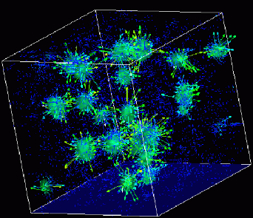

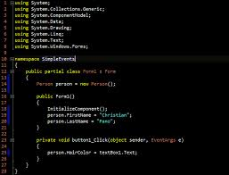
Advanced
Scientific Computing
(SciComp 201)
Session 25
Dynamical Systems

Slide 2
Seminar Goals
Introduce Dynamical Systems and Fractional Dimensions
Discuss Stable Orbits & Analyze the Logistics Map
Review Bifurcation and Feigenbaum's Constant
Visualize the Mandelbrot Set

Slide 3
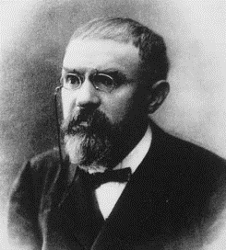
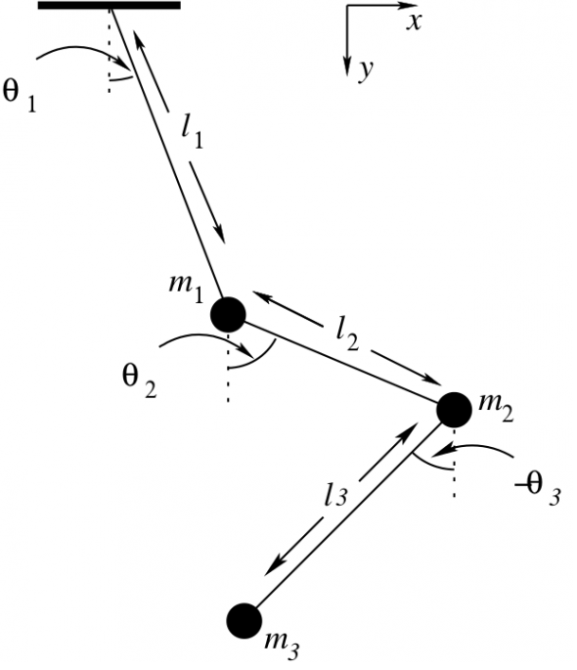
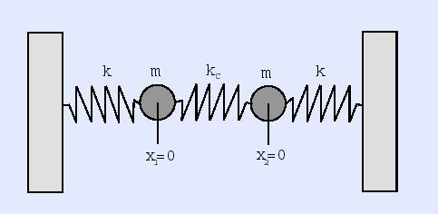
Dynamical Systems
Initially formalized by Henri Poincaré in 1905
A dynamical system is a set of equations describing how points in space vary over time
Triple pendulums, connected springs, turbulence
Predator-Prey equations, stock market fluctuations
At any time, a dynamical system has a state given by a set of numbers (a vector) that represents a point in a geometrical manifold
Small changes in the initial state vector can lead to wild swings in the long term system output – the system may descend into chaos

Slide 4
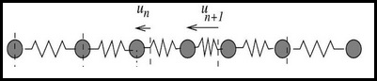
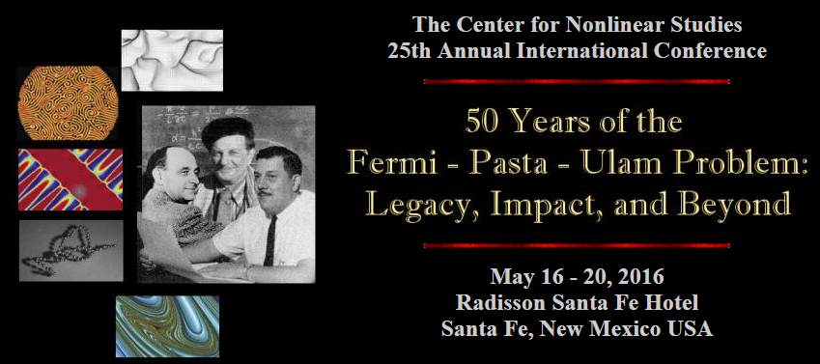
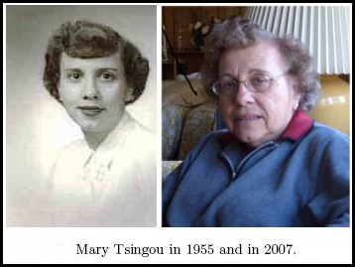
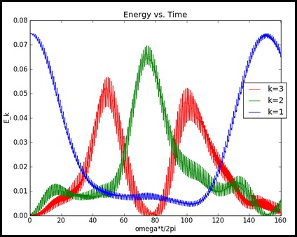
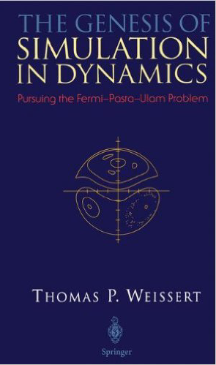

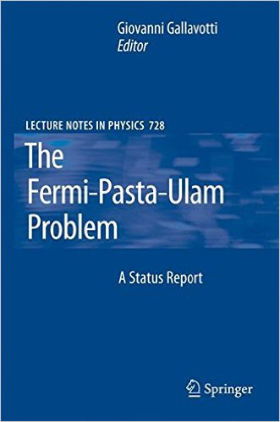
FPU – Birthplace of SciComp

Slide 5
Stable Orbits
A simple dynamical system can be generated by invoking a single function over and over again
It is not that the function is recursive (it does not call itself), but that the function is put into what is known as a closed loop
The output of the prior iteration is passed as input parameters into the next iteration
We study the trajectory of the output values as we iterate from the given initial state vector
The function may be stable under iteration, meaning it closes onto into a finite repeating sequence of values (an orbit) – this is also know as the “strange attractor” of the system
Alternatively, the function may blow up and rapidly reach +/- ∞

Slide 6
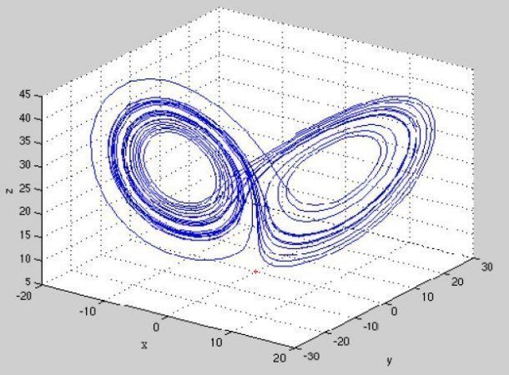
Stable Orbits

Slide 7
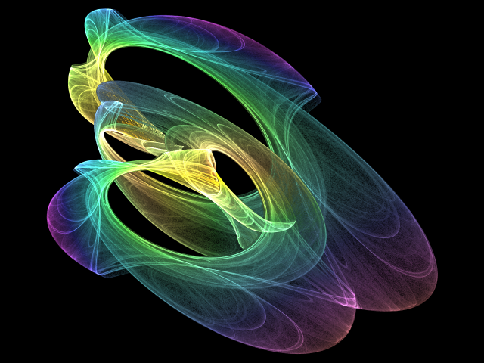
Stable Orbits

Slide 8
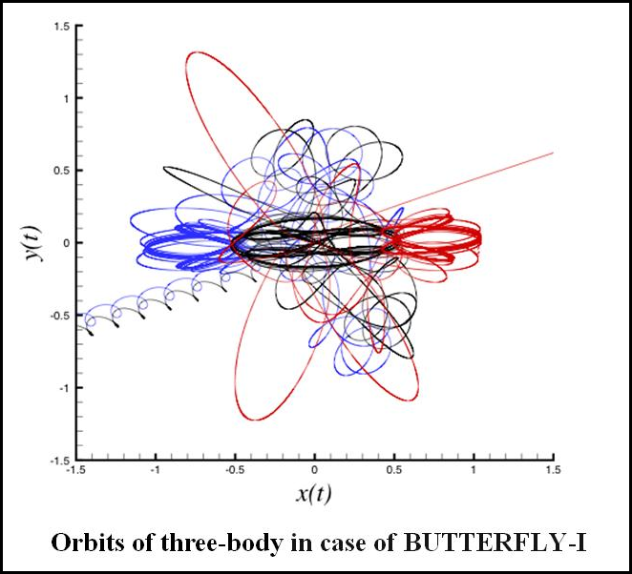
Unstable Orbits
After some chaotic “circling” the particles eventually fly off in opposite directions

Slide 9
The Logistic Map
For some dynamical systems, the eventuality of achieving convergence to orbital stability, or the rapid divergence to chaos (or infinity), can be unexpectedly affected by the tiniest change in the initial state vector
Consider the logistic map, a non-linear equation:
$$y_{n+1}=x∙y_{n}∙\left(1−y_{n}\right)$$
For a given $x$ and a random $y_{0}$ we iterate this function
It is amazing how even this simple formula behaves so wildly for slightly different values of $x$
Also surprising is that it matters little what we pick for $y_{0}$ – if the orbit is stable, it will eventually converge to the same repeating sequence for the given $x$

Slide 10
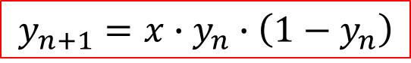
The Logistic Map
We pick a fixed value for x:
$$0 <x ≤4$$
$$y_{n+1}=x∙y_{n}∙\left(1−y_{n}\right)$$
The output of each iteration becomes the new input
We pick a random initial value for y:
$$0 <y <1$$
After a few iterations, the orbit is now stable with a single period

Slide 11
The Logistic Map
$$y_{n+1}=x∙y_{n}∙\left(1−y_{n}\right)$$
After a few iterations, the orbit is now stable with a period of 2
Same $y_{0}$but now with x = 3.4

Slide 12
The Logistic Map
$$y_{n+1}=x∙y_{n}∙\left(1−y_{n}\right)$$
After a few iterations, the orbit is again stable with a period of 2
Same x but with different $y_{0}$
It is the value of x (the initial state vector in this dynamical system) that determines the orbital period, not $y_{0}$

Slide 13
The Logistic Map
$$y_{n+1}=x∙y_{n}∙\left(1−y_{n}\right)$$
Now the orbit has a period of 4 This is called period doubling
Same $y_{0}$but now with x = 3.52

Slide 14
The Logistic Map
$$y_{n+1}=x∙y_{n}∙\left(1−y_{n}\right)$$
Now there is no stable orbit.
There is no repetition in the sequence of output values.
Same $y_{0}$but now with x = 4.0
This is called “chaos”

Slide 15
Lab 1 – Draw the Logistic Map
The goal is to draw the Logistic Map on screen to see the values for x where period doubling occurs
The function we wish to iterate is: $y_{n+1}=x∙y_{n}∙\left(1−y_{n}\right)$
We will slowly vary x from 2.5 up to 4.1 in steps of $∆x$
Then for each current x value:
We pick a random starting value for y where $0 <y <1$
We then iterate the logistic map equation 500 times to ensure it has a good chance to reach its stable orbit (if one exists) for the current value of x
Finally we iterate the equation another 500 times, but this time within each iteration of the equation, we plot on screen the point at the current value of x and y

Slide 16
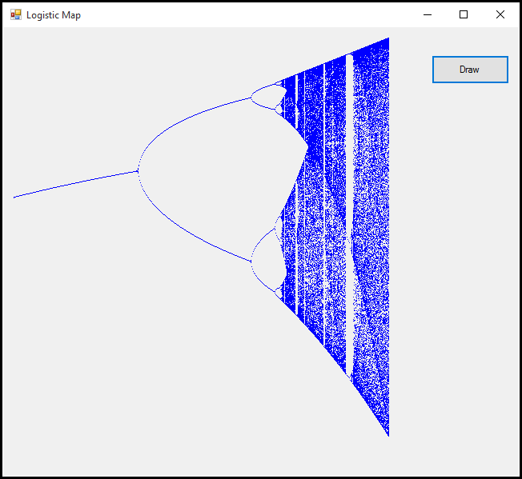
Lab 1 – Draw The Logistic Map
For each $x$ value, we first pick a random $y_{0}$
We then iterate the function 500 times without plotting its value
After the first 500 iterations, we then plot on screen the value of the next 500 iterations
Increasing y (0 < y < 1.0)
Increasing $x$ (2.5 < $x$ < 4.1)

Slide 17
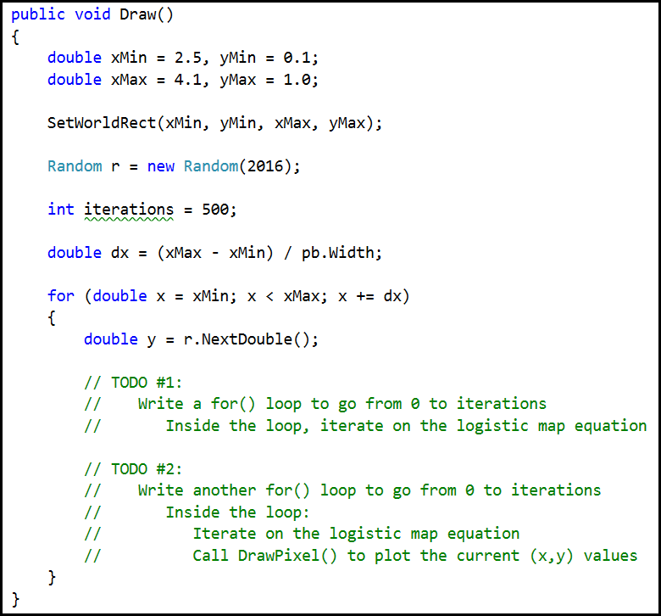
Lab 1 – Draw The Logistic Map

Slide 18
Lab 1 – Draw the Logistic Map
The goal is to draw the Logistic Map on screen to see the values for x where period doubling occurs
The function we wish to iterate is: $y_{n+1}=x∙y_{n}∙\left(1−y_{n}\right)$
We will slowly vary x from 2.5 up to 4.1 in steps of $∆x$
Then for each current x value:
We pick a random starting value for y where $0 <y <1$
We then iterate the logistic map equation 500 times to ensure it has a good chance to reach its stable orbit (if one exists) for the current value of x
Finally we iterate the equation another 500 times, but this time within each iteration of the equation, we plot on screen the point at the current value of x and y

Slide 19
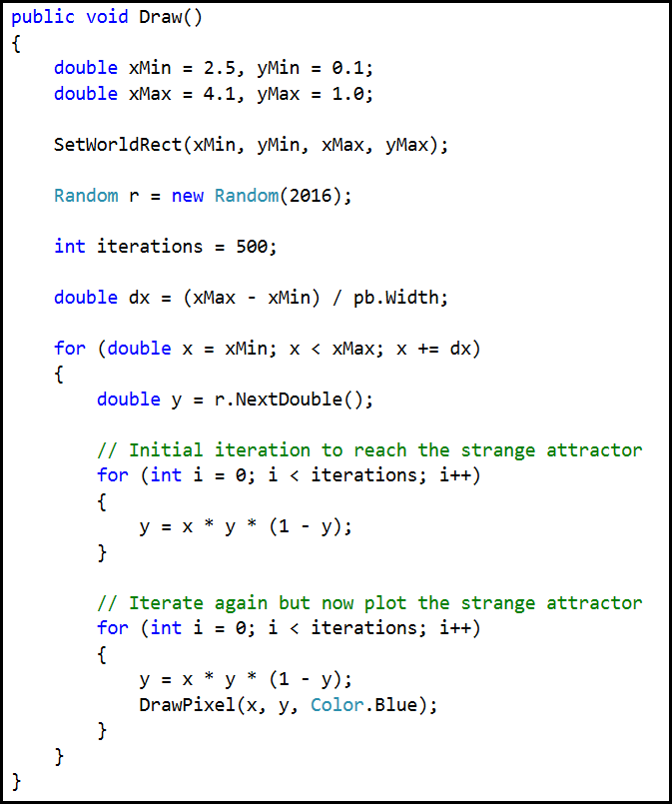
Lab 1 – Draw The Logistic Map

Slide 20

Lab 1 – Draw The Logistic Map
If 3 < $x$ < 3.449
y oscillates between two (changing) values as x increases
If 3.449 < $x$ < 3.544
y oscillates between four (changing) values as x increases
As$x$ continues to increase, the orbit doubles in number of stable points – this is bifurcation
Increasing y (0 < y < 1.0)
Increasing $x$ (2.5 < $x$ < 4.1)

Slide 21
The Logistic Map
The logistic map shows unexpected major changes in its trajectory (or orbit) under iteration for small changes in $x$
$$y_{n+1}=x∙y_{n}∙\left(1−y_{n}\right)$$
What is it about those specific values of $x$ that causes the period to bifurcate?
Why does it not matter what $y_{0}$ value is first used?
Just as an infinite series might converge to a limit, an iterated dynamical system might “converge” to a strange attractor

Slide 22

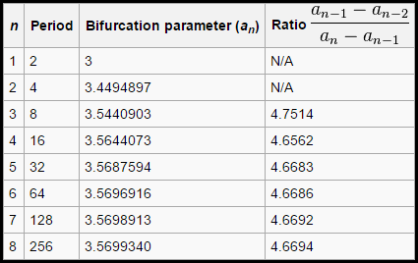
Feigenbaum Constant
In 1978, Mitchell Feigenbaum was a young student in New York City holding his very first calculator
He wondered if there was anything interesting in the ratio of the specific values for x which cause the logistic map to bifurcate (i.e. to double the period of the strange attractor)
All dynamical systems seem to share this lurking constant!
It is the $π$ of the
21st century!

Slide 23

Feigenbaum Constant

Slide 24
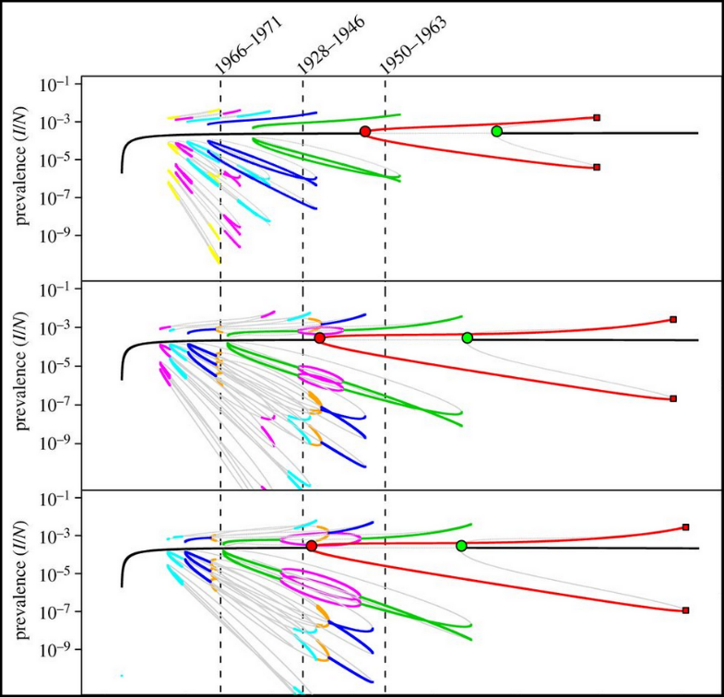
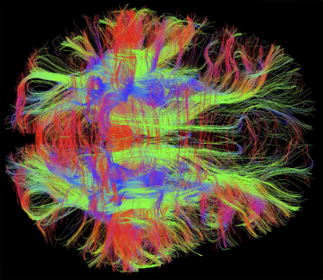
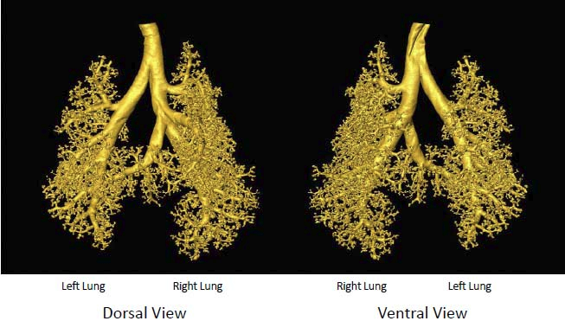
Feigenbaum Constant

Slide 25
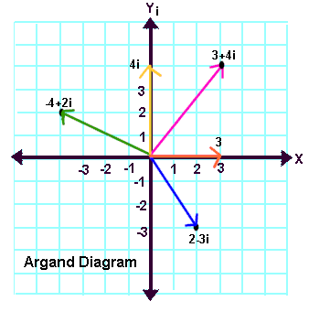
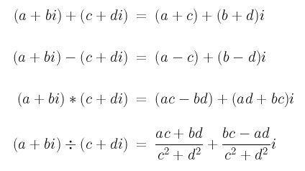
Complex Number Algebra
$$magnitude= \sqrt{a^{2}+b^{2}}$$

Slide 26

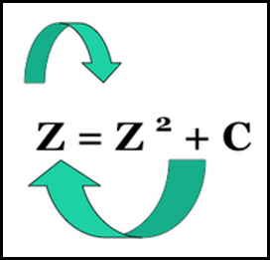
The Mandelbrot Set
In 1980 Benoit Mandelbrot considered the logistic map but expanded the domain to include complex numbers
Mandelbrot asked what happens if we square a complex number (a + bi) every iteration
How many iterations will it take before its magnitude > 2.0?
Are there points where the iterated magnitude never exceeds 2.0?
Mandelbrot wondered what unknown bifurcations and strange attractors might be hiding in the set of complex numbers when under iteration?

Slide 27
The Mandelbrot Set
Mandelbrot’s algorithm:
Take every point in the complex plane and keep squaring it
Count the number of iterations before the magnitude exceeds 2.0
If magnitude remains $≤$ 2.0 then color that (a,b) coordinate black
If $>$ 2.0, then color that (a,b) coordinate according to a randomized color palette that identifies the number of iterations it took to escape
The “escape time” represents the number of iterations for the magnitude to grow beyond 2.0

Slide 28
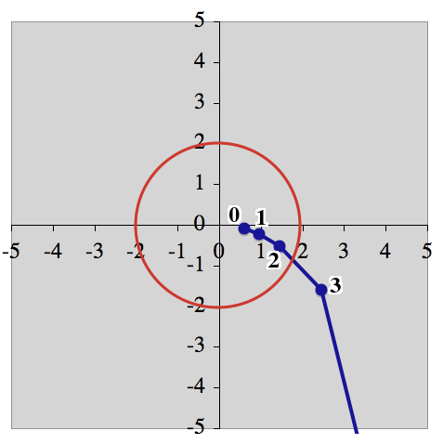
The Escape Time

Slide 29
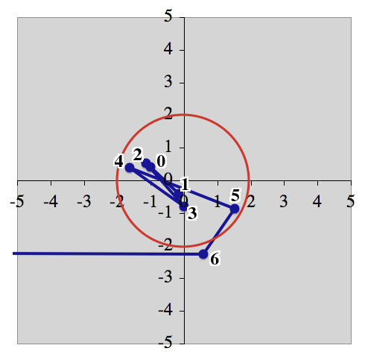
The Escape Time

Slide 30
The Mandelbrot Set
When Mandelbrot first rendered his dynamical system on a color display, the image amazed everyone…
The set of complex numbers (squared) contains an internally consistent self-similarity at infinite levels of zoom!
Open and run Lab 2 then click the “Draw” button

Slide 31

Lab 2 – Mandelbrot Set

Slide 32
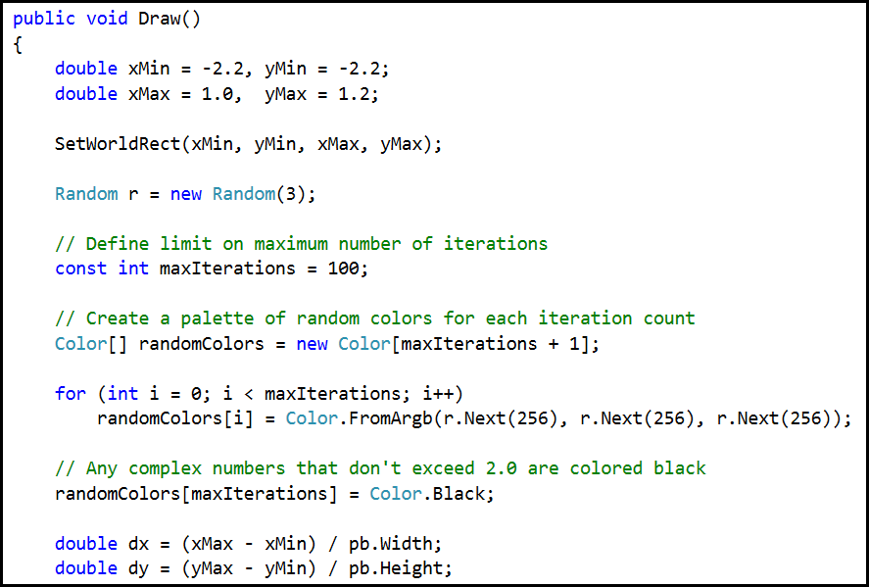
Lab 2 – Mandelbrot Set

Slide 33
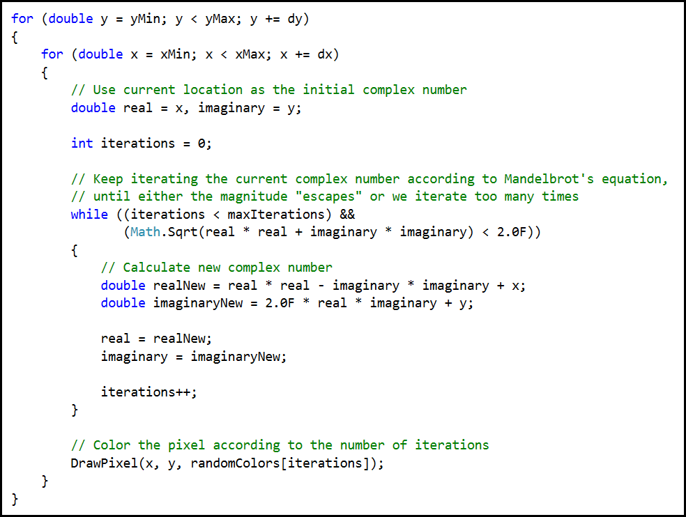
Lab 2 – Mandelbrot Set

Slide 34
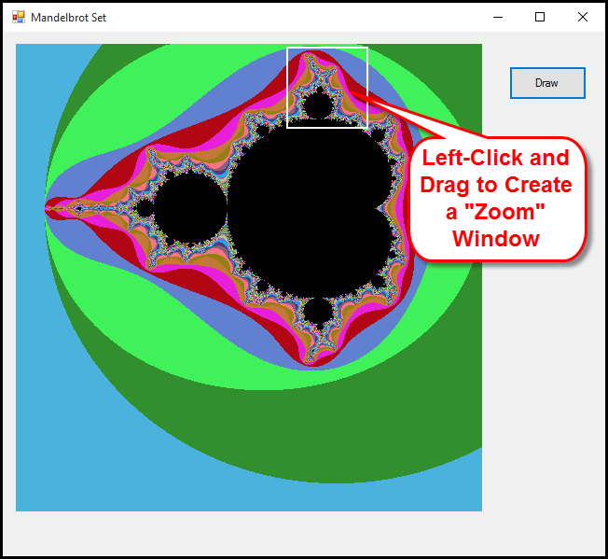
Lab 2 – Mandelbrot Set

Slide 35
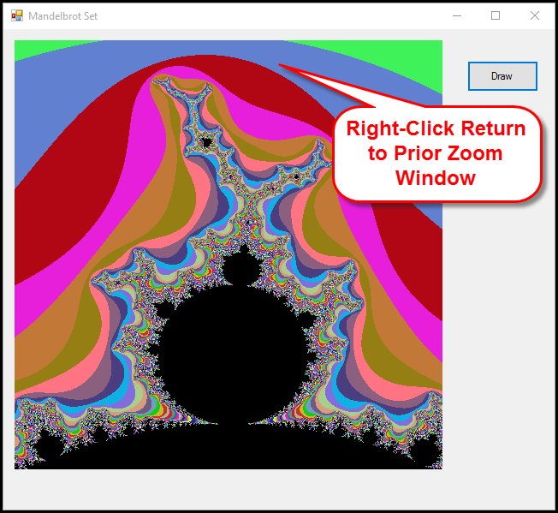
Lab 2 – Mandelbrot Set

Slide 36
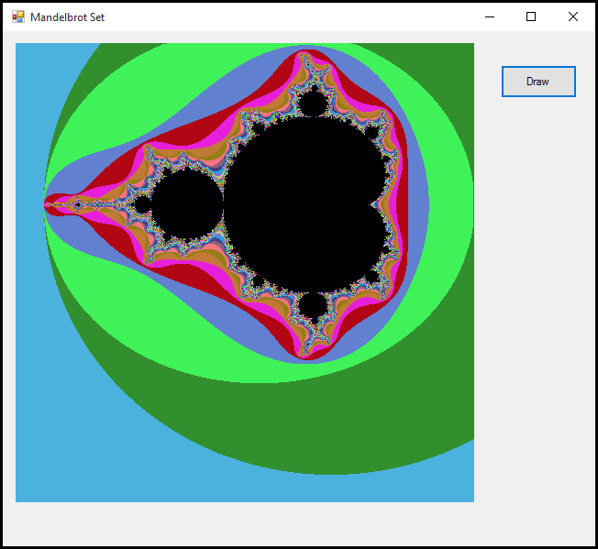
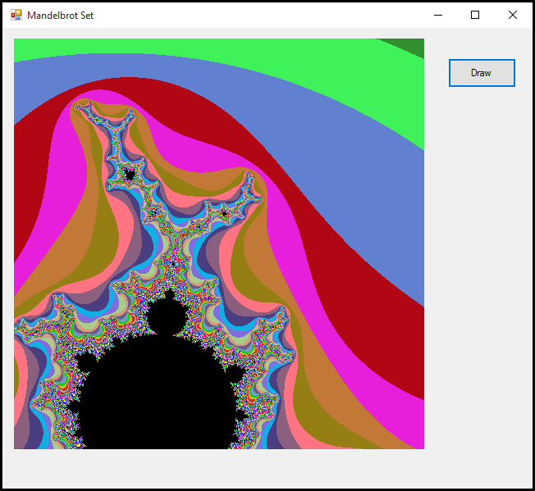
Lab 2 – Mandelbrot Set
As we zoom in (by shrinking the world rectangle) we see the Mandelbrot set completely repeating itself on infinitely smaller and smaller levels

Slide 37
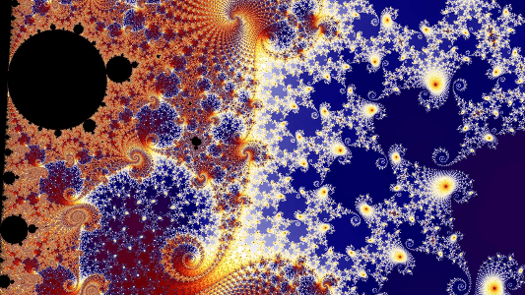



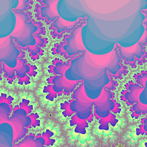

Slide 38
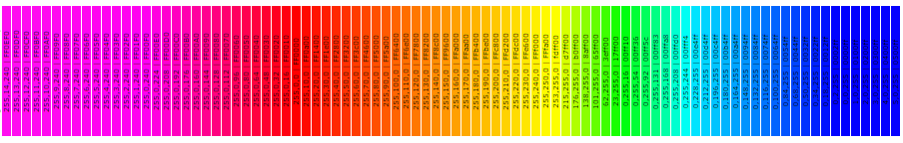
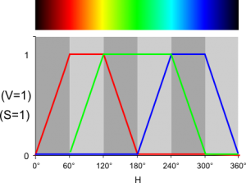
RGB Color “Temperature”

Slide 39
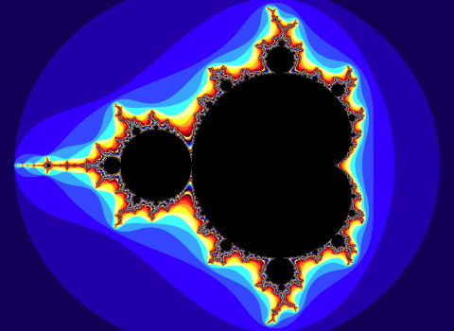
Mandelbrot Set

Slide 40
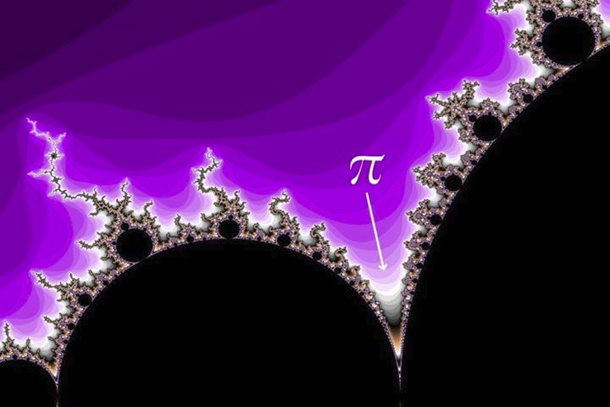

Slide 41
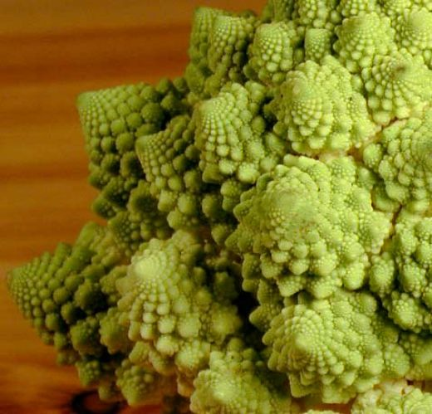
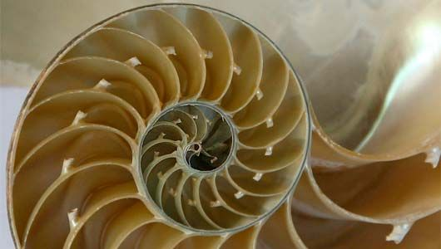

Slide 42

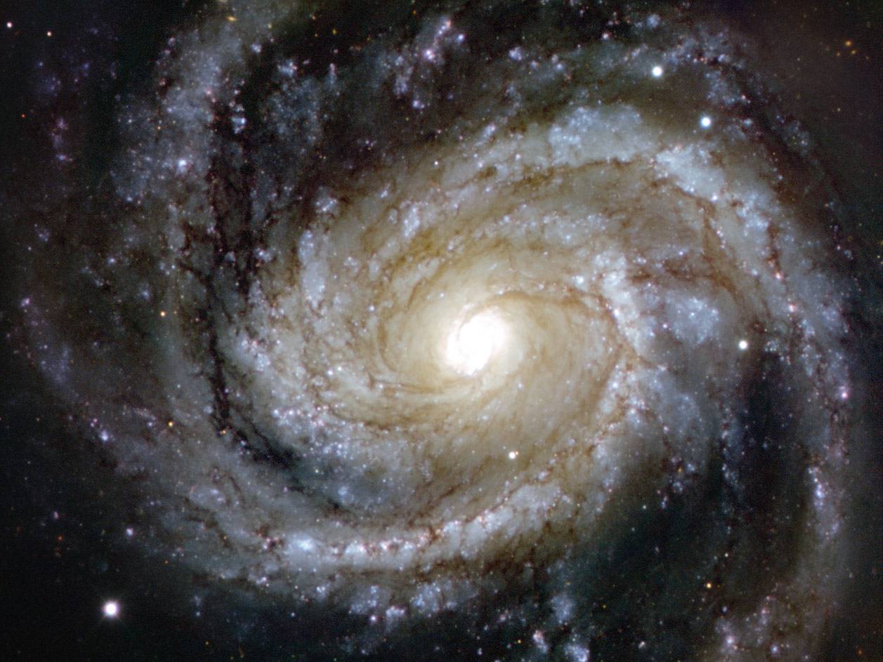

Slide 43
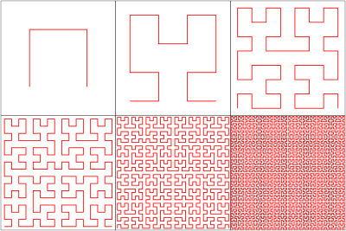
Infinite Self-Similarity Creates Fractal Dimensions
A line is a 1D object
As the line folds and twists, it begins to occupy a 2D plane
If it continues to replicate itself at infinitely smaller detail, the 1D line will start becoming a 2D object
The line now has a fractional dimension, greater than 1, but not quite 2

Slide 44



Slide 45
Now you know…
A dynamical system is composed of one or more equations that are iterated over and over. We analyze their trajectory, orbit, and escape velocity
Many dynamical systems exhibit bifurcation, also called period doubling, that may eventually lead the system to chaos
Dynamical systems may display stable or semi-stable strange attractors, which can result in long sequences of values repeating over time
The Mandelbrot Set displays an unexpected and massive degree of self-similarity
Self-similarity preserved over ever decreasing scale leads to mathematical objects with fractional dimensions (fractals)

